Slide 1
Performance verification
Comparison of power curves, iSpin/SCADA: “iSpin Guardian”
Nick Janssen
Lasse M. Sørensen

Slide 2
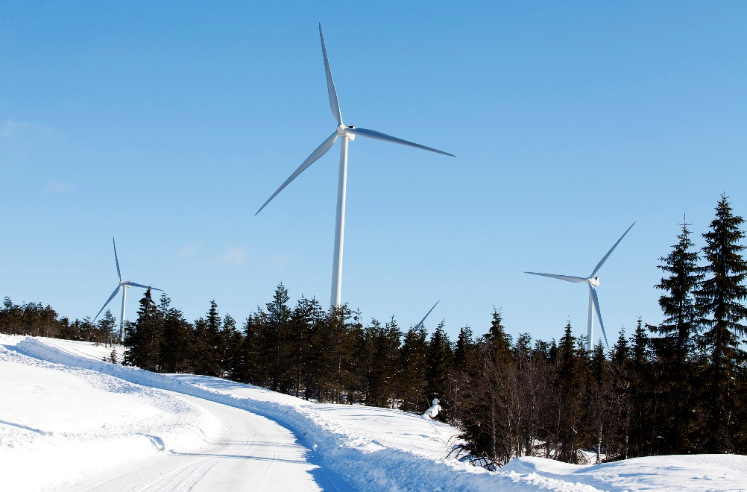
Site details
Northern Sweden
40 x 2 and 1.8MW turbines
  Hills and small mountains
  Low growing Swedish forest
High turbulence area
Varying inflow due to terrain
iSpin NTF to free wind, developed from
flat site in Spain

Slide 3
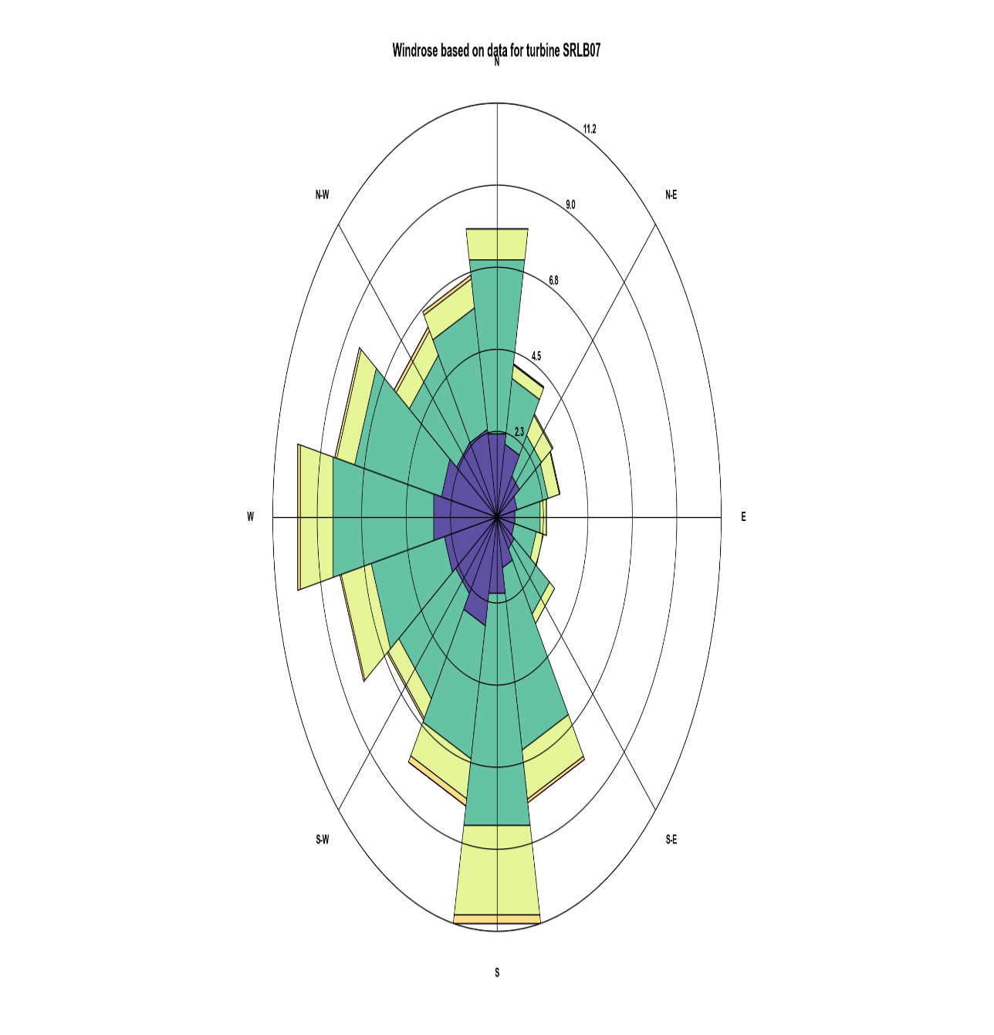
Project and turbines
Time frame: 09/01-2015 until 08/16-2016
Turbine type
  40 x V90-2MW
  All equipped with iSpin
  Tower height = 95 meters
  11 turbines de-rated to 1,8 MW (this analysis focus on turbines with rated power)
  Remaining turbines operating at 2 MW
  Area
Average wind speed = 6 m/s
  Wind direction is mostly West/South
Temperature (Celsius)
  Average = 2,34
  Max = 22,63
  Min = -23,37 (January) →Tremendous icing problems
  Calibration
  On a semi-complex site in Spain

Slide 4
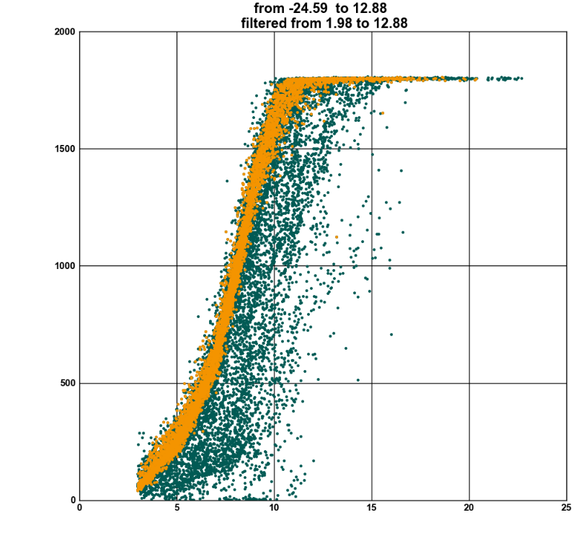
Applied filters
Wind speed > 3 m/s
Average angular rotor speed > 50 deg/s
Minimum angular rotor speed > 20 deg/s
Ambient temperature > 2 degree Celsius (to remove icing)
  Exclude non-producing periods
  360 degree round (also wake) taken into account
  No turbine log was available – i.e. difficult to filter out emergency/service stops etc.
Orange: 10 minute samples with T > 2 deg C
Green: 10 minute samples with T < 2 deg C

Slide 5
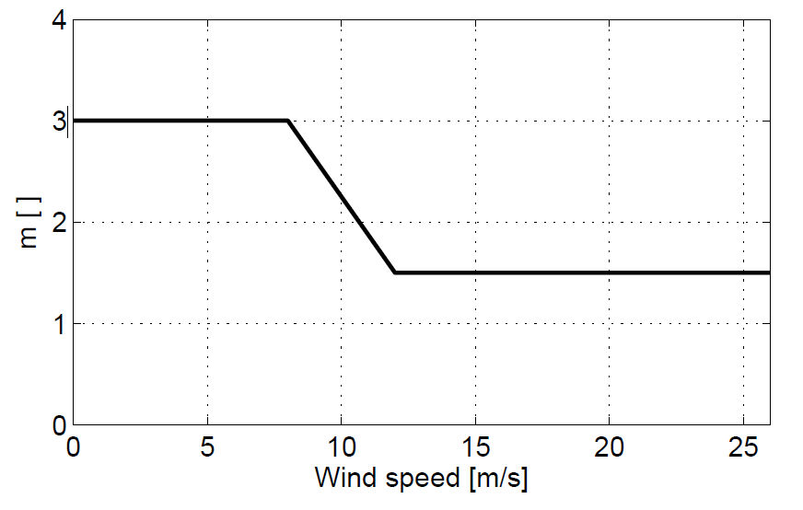
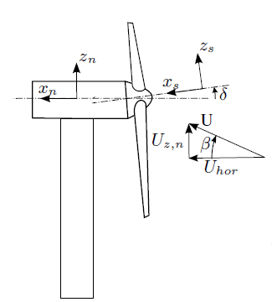
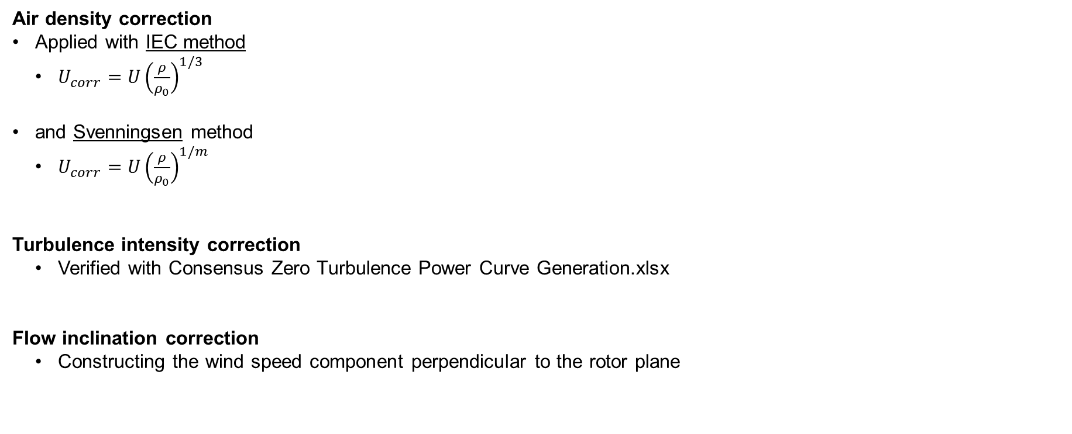
Corrections
  Air density correction
  Applied with IEC method
    $U_{corr}=U{\left(\frac{ρ}{ρ_{0}}\right)}^{1/3}$
  and Svenningsen method
    $U_{corr}=U{\left(\frac{ρ}{ρ_{0}}\right)}^{1/m}$
  Turbulence intensity correction
    Verified with Consensus Zero Turbulence Power Curve Generation.xlsx
  Flow inclination correction
    Constructing the wind speed component perpendicular to the rotor plane
Source: Svenningsen, L. (2010) Proposal of
an Improved Power Curve Correction. EMD
International A/S, EWEC 2010
Source: http://www.ingdemurtas.it

Slide 6
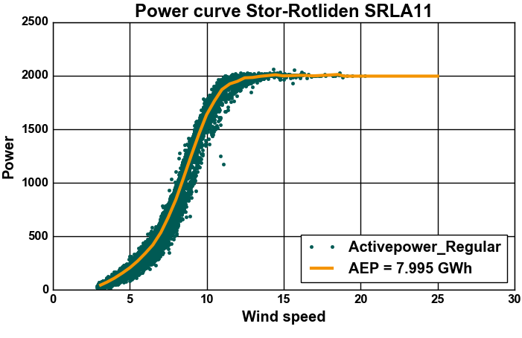
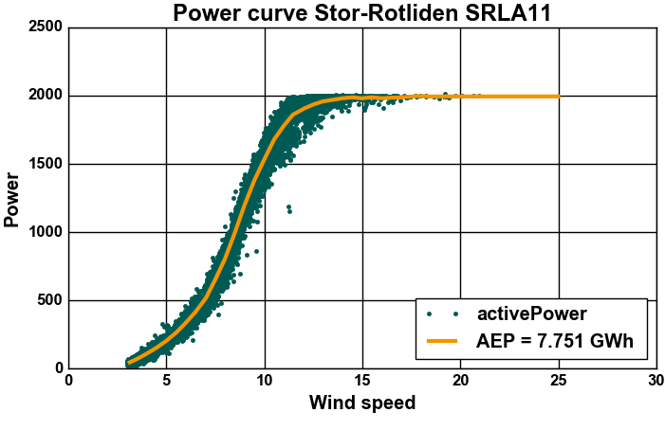
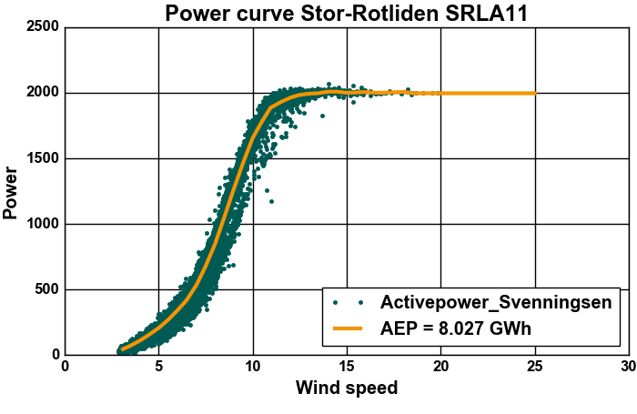
Results - Normalization
Air density (IEC)+
Turbulence intensity+
Flow inclination
normalization
Un-normalized power curve
Air density (Svenningsen)+
Turbulence intensity+
Flow inclination
normalization

Slide 7
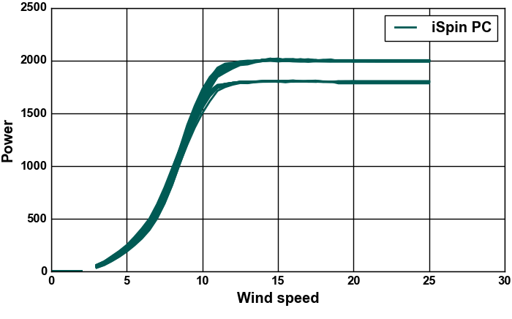
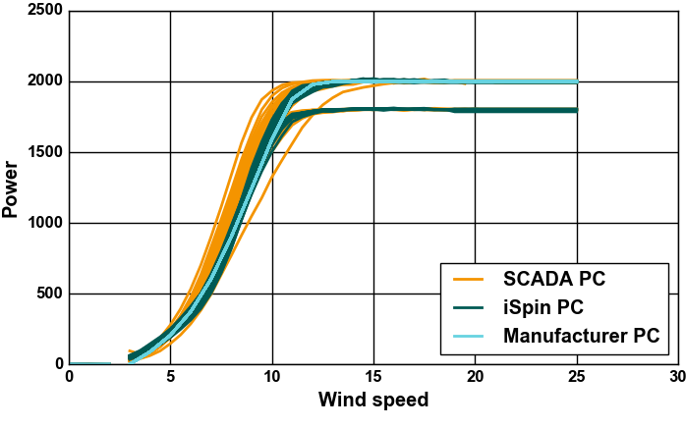
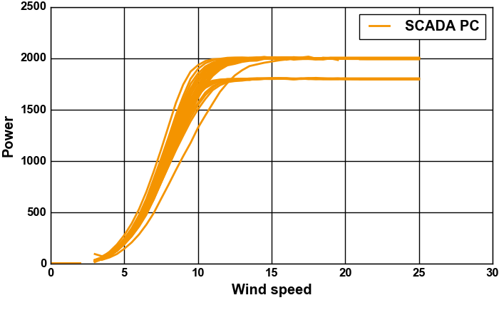
Results – all 40 turbines
Using:
Air density correction (IEC)
Turbulence intensity correction (PCWG)
Flow inclination correction (ROMO)
‘iSpin Guardian’

Slide 8
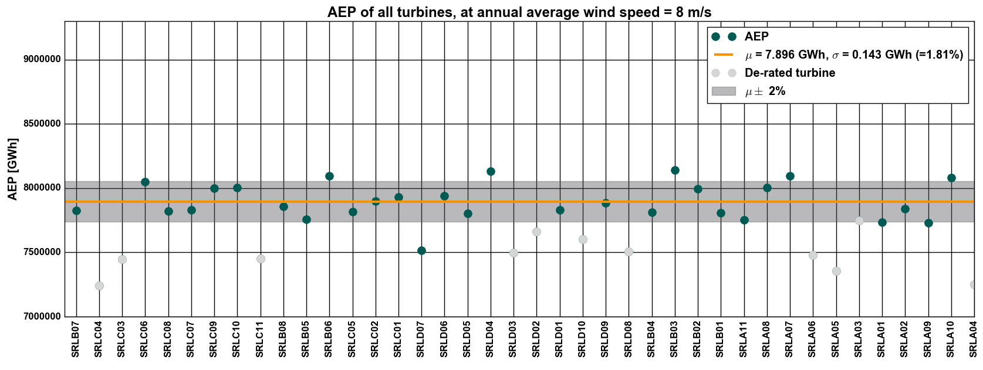
Effect of normalizations on AEP (8m/s)
Uncorrected

Slide 9
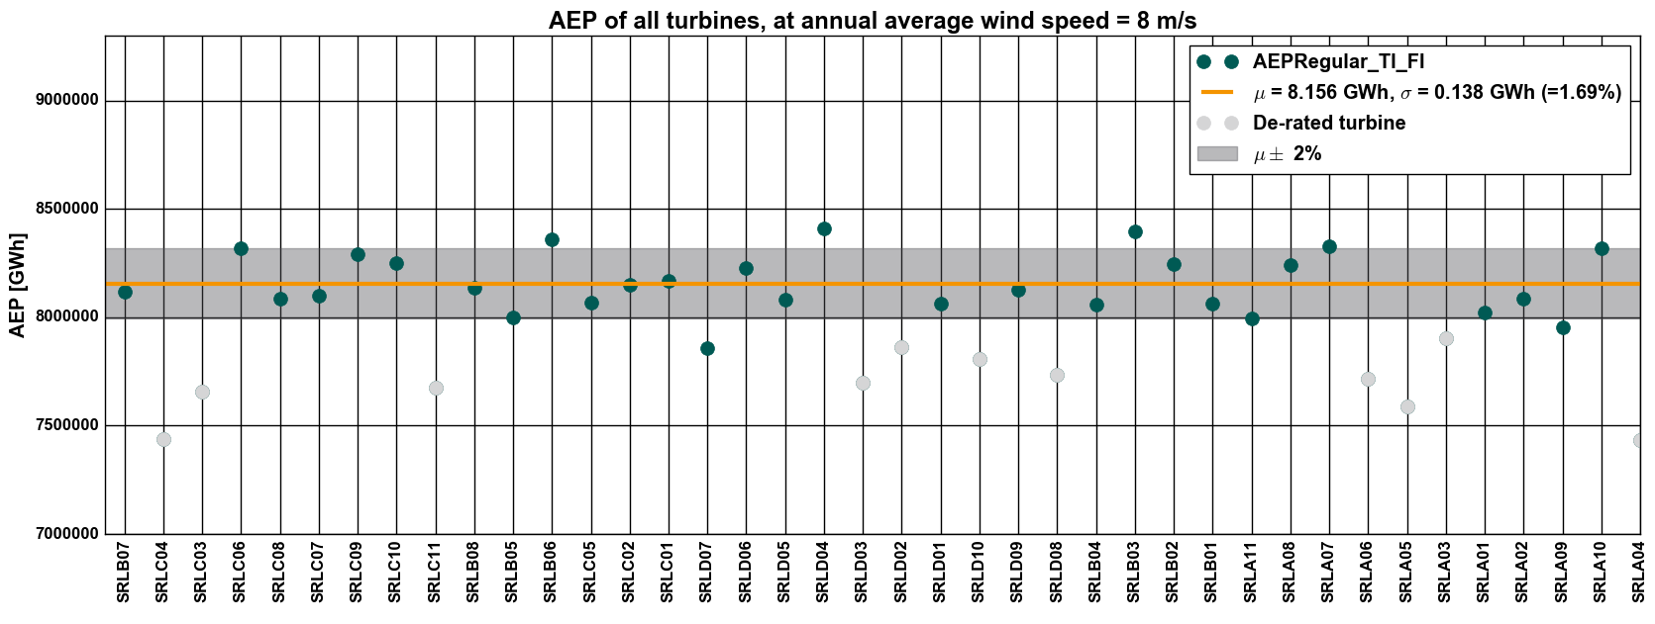

Effect of normalizations on AEP (8m/s)
Normalized
Effect on AEP is small ($σ_{uncorrected}=0.143 GWH$ vs $σ_{normalized}=0.138 GWH$)
i.e. a difference of 0.005 GWH (0.06% of avg) in standard dev.

Slide 10
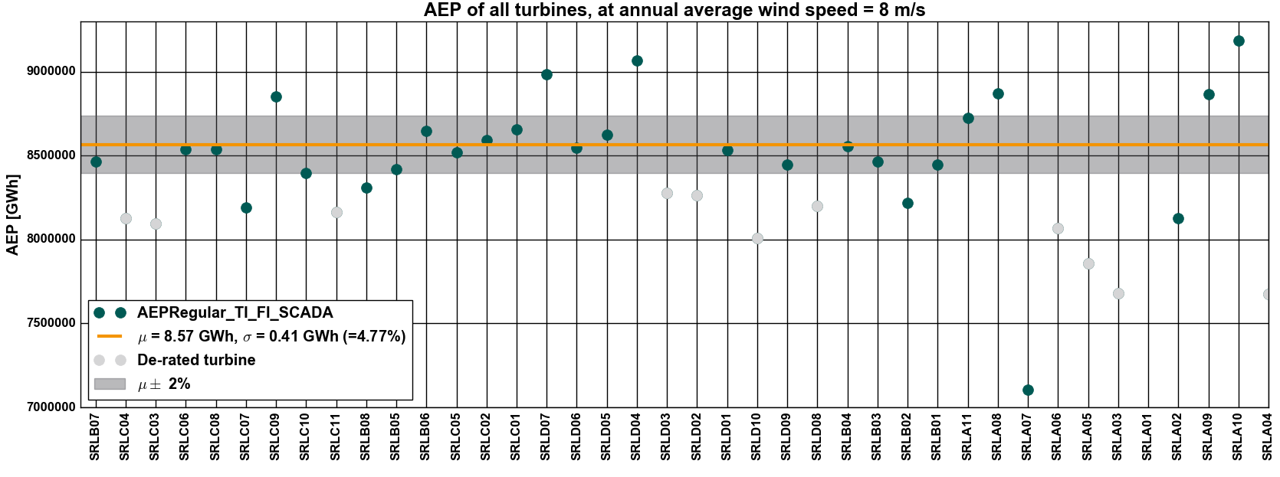

Comparison to SCADA AEP
Normalized
But at least iSpin gives much more comparable AEPs than SCADA. ($σ_{iSpin}=0.138 GWH$ vs $σ_{SCADA}=0.41 GWH$)
i.e. a difference of 0.272 MWH (3.2% of avg) in standard dev.

Slide 11
Conclusion
Correlation between the 40 PC is good in all power curves for the iSpin
Correlation between the 40 PC is bad compared with all power curves for the SCADA
Difficult (impossible in northern Sweden) to measure a power curve in winter due to icing
Based on this comparison and analysis it can be seen that a similar AEP is possible for the 29 non-derated turbines, with applied filters and corrections when using iSpin data
  Allows to spot under-performing turbines
  After all normalizations, AEP from turbine to turbine varies in the order of ~2% (iSpin) and ~ 5% (SCADA)

Slide 12
ngj@romowind.com
lms@romowind.com

Slide 13

